Slide 1
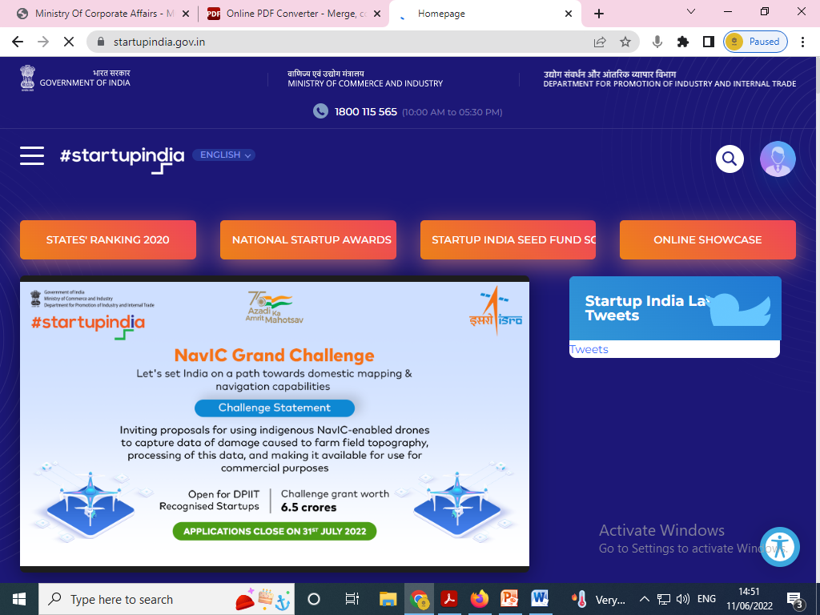
START UP INDIA
Boon for Startups

Slide 2
DEFINITION OF STARTUP AS DEFINED ON DPIIT PORTAL
(Official Gazette dated- 06/07/2021)
An entity shall be considered as a Startup:
Upto a period of ten years from the date of incorporation/ registration, if it is incorporated as a private limited company (as defined in the Companies Act, 2013) or registered as a partnership firm (registered under section 59 of the Partnership Act, 1932) or a limited liability partnership (under the Limited Liability Partnership Act, 2008) in India.
Turnover of the entity for any of the financial years since incorporation/ registration has not exceeded one hundred crore rupees.
Entity is working towards innovation, development or improvement of products or processes or services, or if it is a scalable business model with a high potential of employment generation or wealth creation.
Provided that an entity formed by splitting up or reconstruction of an existing business shall not be considered a ‘Startup’.
An entity shall cease to be a Startup on completion of ten years from the date of its incorporation/ registration or if its turnover for any previous year exceeds one hundred crore rupees.

Slide 3
STARTUP ECOSYSTEM IN INDIA
.
solving problems in 56 diverse industrial sectors with 13% from IT services, 9% healthcare and life sciences, 7% education, 5% professional and commercial services, 5% agriculture and 5% food & beverages.
India has emerged as the
3rd largest ecosystem for startups globally
with over 69,000 DPIIT-recognized startups across 647 districts of the country as of 02nd May 2022.

Slide 4
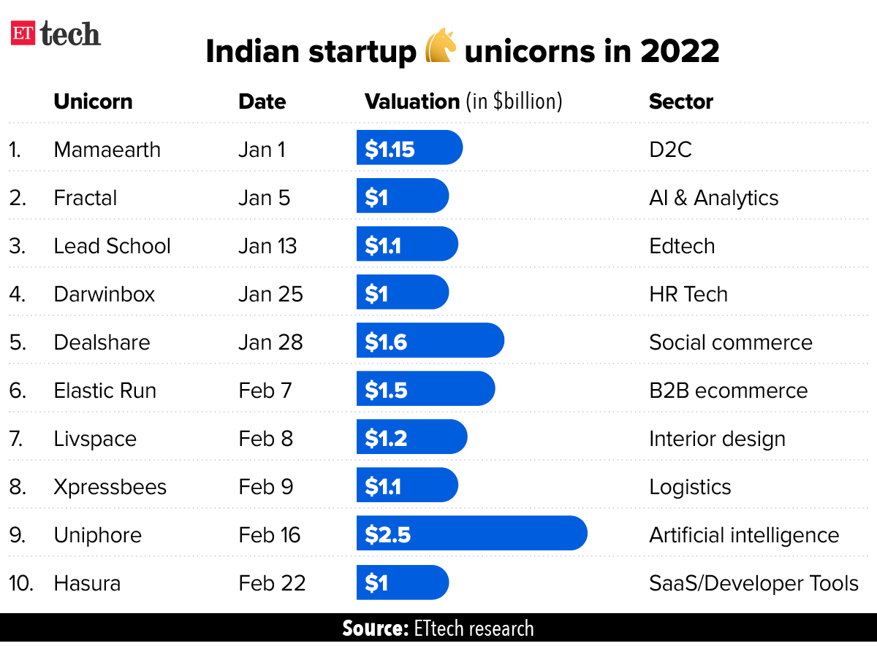

Slide 5
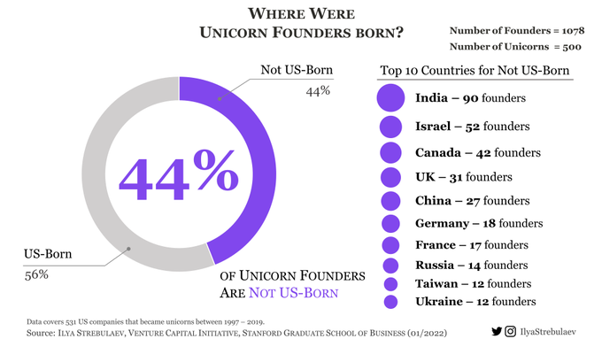
90 founders among 500 US unicorns were India born: Study
New Delhi: A study compiled by Ilya A. Strebulaev, professor of finance at Stanford University’s Graduate School of Business, shows that out of 1,078 founders across 500 US unicorns, 90 entrepreneurs were born in India, signalling the significant presence of Indian Americans in the country’s startup and tech economy.

Slide 6
TOTAL STARTUPS REGISTERED IN INDIA
"Sustained government efforts in this direction have resulted in increasing the number of recognized startups from 726 in FY 2016-17 to 65,861 in FY 2021-22 (as on 14th March 2022),“
He said that the recognized startups are spread across over 640 districts and have reported a creation of more than seven lakh jobs with an average of 11 jobs being created by them.
The recognized startups, he said, are spread across 56 diversified sectors such as IT services, finance technology, technology hardware, enterprise software, artificial intelligence, and nanotechnology.

Slide 7
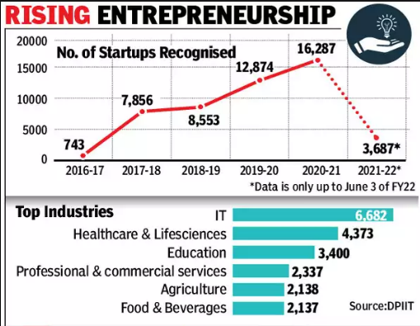

Slide 8
A STARTUP INCUBATOR is a collaborative program designed keeping in mind to help new startups succeed. The main goal of a startup incubator is to help entrepreneurs grow their businesses. Mostly, startup incubators are non-profit organizations that are usually run by both public and private entities.
Startup incubators play the most needed and important part of the startup ecosystem. As of 2019, there were 13 central government ministries and departments that were supporting incubators. In total, 284 incubators were identified in India and they included both government supported and private
incubators.
Top 10 Startup Incubation Centers-
1. CIIE IIMA 6. CEI IIMC
2. IAN incubator 7. Kerala Startup Mission
3. Sine 8. IIML - Incubator
4. STEP 9. pupilfirst
5. Nsrcel 10. Villgro

Slide 9
INCUBATION CENTERS IN Madhya Pradesh
There are total 32 incubation centers in Madhya Pradesh and
5 incubation centers running in Bhopal. These are-
B Nest
Work Space City
VASPL Initiatives P Ltd
AIC - AART ECH
MANIT Rolta Incubation centre (MRIC)
(Source- https://mpmsme.gov.in/website/incubation-network ,
https://www.smartfood.org/wpcontent/uploads/2020/03/Incubators.pdf )

Slide 10
STARTUPS IN MADHYA PRADESH
As Quoted in the Madhya Pradesh Startup Policy 2022 currently there are :
-2058 DIPP Recognized Startups, and
-904 Women-Led Startups/Women Entrepreneurs
Like most tier-II cities, a craze for startups can also be seen in Bhopal, a city in Madhya Pradesh. The state government of Madhya Pradesh has been working side by side with the central government on promoting startup culture and increasing entrepreneurial spirit in the state.
Here's a list of leading Startups in Bhopal.
-Easy Retail For You -Easy R -Netlink -Appointy - IT Fusion -HackerKernal -CollegeKhabri -GypsyShack -KhaDigi -Onnway -TheKabadiwala -Vizzbee -BusinessKeeda

Slide 11
RECOGNITION PROCESS
The process of recognition of an eligible entity as startup (DPIIT Certified startup) shall be as under: —
A Startup shall make an online application over the mobile app or portal set up by the DPIIT.
The application shall be accompanied by—
(a) a copy of Certificate of Incorporation or Registration,
(b) a write-up (Pitch Deck) about the nature of business highlighting how it is working towards innovation, development or improvement of products or processes or services, or its scalability in terms of employment generation or wealth creation.
3. The DPIIT may, after calling for such documents or information and making such enquires, as it may deem fit, —
(a)recognise the eligible entity as Startup;
(b)reject the application by providing reasons.

Slide 12

Benefits to recognized Start-ups-
-SELF-CERTIFY and comply under 9 Labour Laws and 3 Environmental laws.
Building and Other Construction Workers Act,1996
The Inter-State Migrant Workmen Act, 1979
The Payment of Gratuity Act, 1972
The Contract Labour (Regulation and Abolition) Act, 1970
The Employees’ Provident Funds and Miscellaneous Provisions Act, 1952
The Employees’ State Insurance Act, 1948
The Industrial Disputes Act,1947
The Trade Unions Act,1926
The Industrial Employment (Standing Orders),1946
The Water (Prevention & Control of Pollution)Act, 1974
The Water (Prevention & Control of Pollution) Cess (Amendment) Act, 2003
The Air (Prevention & Control of Pollution) Act, 1981

Slide 13
-TAX EXEMPTIONS
Under Section 80 IAC of Income Tax Act, 1961
Post getting recognition a Startup may apply for Tax exemption under section 80 IAC of the Income Tax Act. Post getting clearance for Tax exemption, the Startup can avail tax holiday for 3 consecutive financial years out of its first ten years since incorporation.
Profit Exemption to eligible Startup entities under Section 80-IAC:
Deduction at the rate of 100% of its profits and gains is allowed to an eligible startup for 3 consecutive assessment years out of the 7 years (10 years from 01.04.2020) beginning from the year of incorporation.
As per Section 80-IAC, an entity shall be considered as an eligible startup if it fulfills following conditions:
(Continued…..)

Slide 14
-It is incorporated as a company (Private Ltd. Co. or Public Ltd. Co.) or an LLP.
-It is incorporated on or after April 1, 2016.
-Its turnover does not exceed Rs.25 Cr (Rs.100 Cr from 01.04.2020) in the previous year relevant to assessment year for which such deduction is claimed.
-It is not formed by splitting up or reconstruction of a business already in existence.
-It holds a certificate of eligible business from the Inter-Ministerial Board of Certification.
-It is engaged in innovation, development or improvement of products or processes or services or a scalable business model with a high potential of employment generation or wealth creation.
Note: For Claiming under section 80-IAC , A recognized startup is required to file Form 1 along with the specified documents to the Inter-Ministerial Board of Certification. The board may call for certain documents or information and may make such enquiries, as it deems fit, to recognize the entity as an eligible startup and grant a certificate for claiming exemption under section 80-IAC. The board may reject the application by providing the reasons thereof.

Slide 15
Under Section 56 of the Income Tax Act (Angel Tax)
Post getting recognition a Startup may apply for Angel Tax Exemption.
Eligibility Criteria:
-The entity should be a DPIIT recognized Startup
-Aggregate amount of paid up share capital and share premium of the Startup after the proposed issue of share, if any, does not exceed INR 25 Crore.
Angel tax is the tax charged on the closely held company when it issues shares to a resident person at a price which is more than its fair market value. When this provision is triggered, the aggregate consideration received from issue of shares as exceeds its fair market value is charged to tax under the head ‘Income from other sources’ under section 56(2)(viib).

Slide 16

Under Section 54 EE of Income Tax Act, 1961:
A new Section 54 EE has been inserted in the Income Tax Act for the eligible Start-ups to exempt their tax on a long-term capital gain if such a long-term capital gain or a part thereof is invested in a fund notified by Central Government within a period of six months from the date of transfer of the asset.
The maximum amount that can be invested in the long-term specified asset is Rs 50 lakh. Such amount shall remain invested in the specified fund for a period of 3 years. If withdrawn before 3 years, then exemption will be revoked in the year in which money is withdrawn.

Slide 17
Under Section 54GB to individuals or HUF of long term capital gains:
Section 54GB allows the tax exemption on long-term capital gains on the sale of a residential property if such gains are invested to acquire 50% or more equity shares of the eligible startups, tax on long term capital will be exempt provided that such shares are held at least for 5 years from the date of its acquisition.
The Startups shall also use the amount invested to purchase assets and should not transfer asset purchased within 5 years from the date of its purchase.

Slide 18
Under Section 79 of Income Tax Act,1961 to carry forward and set-off the losses:
The loss incurred in any year prior to the previous year shall be carried forward and set off against the income of the previous year, if, all the shareholders of such company who held shares carrying voting power on the last day of the year or years in which the loss was incurred, continue to hold those shares on the last day of such previous year and such loss has been incurred during the period of seven years beginning from the year in which such company is incorporated.
The said clause was inserted vide Finance Act, 2017 in order to facilitate ease of doing business and to promote start-up India.

Slide 19
Income Tax Exemption for Angel Investors in Startups:
Angel Investor is one who invests his money in a startup while it is still finding its feet and still struggling to establish itself in the marketplace.
Up until now, an angel tax of more than 30% was levied on the funds invested by the individuals in an unlisted firm at the share price above the fair market value.
Usually, around 300-400 of the start-ups fund themselves with the angel funding in a year.
The Income Tax Department has exempted the Angel investors, subject to specific conditions that are laid down by the DPIIT, which has offered substantial relief to early-stage investors.

Slide 20

-Other MAJOR EXEMPTIONS:
EASY WINDING OF COMPANY: In 90 days under Insolvency & Bankruptcy Code, 2016.
STARTUP PATENT APPLICATION & IPR PROTECTION: Fast track patent application with up to 80% rebate in filling patents.
EASIER PUBLIC PROCUREMENT NORMS: Exemption from requirement of earnest money deposit, prior turnover and experience requirements in government tenders.

Slide 21
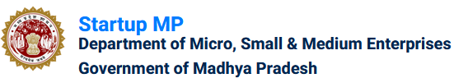
START UP MP
Madhya Pradesh is the second largest state in the country in terms of area and is in the category of leading states in economic development. To boost innovation-driven entrepreneurial culture and to inculcate the spirit of innovation among the immensely talented youth of Madhya Pradesh, GoMP has been making efforts to create a conducive environment to promote entrepreneurship in the state.
It has been the endeavour of GoMP to steer youth-led innovation and to generate maximum employment. The State Government’s approach is to institutionalise the culture of start-up through academic interventions at school and college level and to create an enabling ecosystem by connecting start-ups, investors, incubators and other stakeholders.

Slide 22

MP STARTUP CENTER
Establishment of Start-up centre with subject matter experts under the patronage and aegis of Madhya Pradesh Laghu Udyog Nigam (MPLUN) for facilitation and providing necessary support to start-ups in the state, also providing an institutional platform and providing them ample opportunities in global and local market/events/workshops etc. The centre will act as a dedicated agency for promoting, strengthening and facilitating the start-up ecosystem in the state.

Slide 23
FINANCIAL ASSISTANCE
For a start-up that has received funds/investments from a financial institution recognized by SEBI/RBI, assistance will be given at the rate of 15% maximum upto Rs.15 lakh, of the first investment received. This assistance will be payable at the rate of 15% separately for each of the investments received over a maximum of four stages during the life of the start-up.
In the above context, assistance of Rs. 5 lakh will be given to the concerned incubators located in MP.
Additional 20 percent assistance to Startups set up by Women.
Event Organizing Assistance – Assistance of Rs. 5 lakh per event to incubators located in MP for organizing events related to start-ups not exceeding Rs. 20 lakh per annum.

Slide 24

Incubation Upgradation Assistance - One time assistance of Rs.5 lakhs for the up-gradation of Incubators, but to avail this facility, each Incubator will have to increase its existing seat capacity by an additional 20%.
Lease Rental Assistance – 50% up to a maximum of Rs. 5000/- per month lease rental assistance for three years, on the rent paid per month for the workspace taken on lease by the startups.
Patent Assistance - Maximum assistance of Rs.5 lakh for obtaining a patent subject to the condition that the patent is obtained for a start-up established in the state.

Slide 25

Ease Of Doing Business (EoDB)
For smooth operation of the start-ups and incubators of the state, they have to be facilitated to meet various regulatory requirements. Arrangement of post facto approval will be ensured for necessary permission/consent. Deemed Approval will also be given as per the provisions made in the Madhya Pradesh Public Service Guarantee Act, 2010 (as amended, 2020).

Slide 26
ACADEMIC SUPPORT AND PARTICIPATION
MSME Technology Center, Indore, and Bhopal, National Institute of Design Bhopal, IISER Bhopal, IIITDM Jabalpur etc, to provide the necessary high-tech machinery for the testing, research and development, of the products envisioned by the startups.
Entrepreneurship development courses will be included in the curriculum in secondary, higher secondary and higher educational institutions. Brainstorming and related workshops will be organized regularly in these institutes. Internship will be encouraged to attract students towards entrepreneurship.
In order to make the students aware of the financial and non-financial facilities being provided by the government for starting start-ups, workshops for mutual discussion will be organized twice a year in collaboration with Start-up India.

Slide 27
ELECTRICITY DUTY EXEMPTION
All the product based start-ups' will get Electricity Duty Exemption for 3 years .
(Order Dated 23.02.2022 issued by Ministry of Micro, small & Medium Enterprises)

Slide 28
