Slide 1


HOW TO BUILD A SUCCESSFULL

Slide 2
STARTUP COMPANY MEANING
A startup or start up is a company initiated by individual founders or entrepreneurs to search for a repeatable and scalable business model. Founders design startups to effectively develop and validate a scalable business model. Hence, the concepts of startups and entrepreneurship are similar. However, entrepreneurship refers all new businesses, including self-employment and businesses that never intend to grow big or become registered, while startups refer to new businesses that intend to grow beyond the solo founder, have employees, and intend to grow large. Start ups face high uncertainty and do have high rates of failure, but the minority that go on to be successful companies have the potential to become large and influential. Some startups become unicorns.

Slide 3


Startup India is a flagship initiative of the Government of India, intended to build a strong ecosystem that is conducive for the growth of startup businesses, to drive sustainable economic growth and generate large scale employment opportunities. The Government through this initiative aims to empower startups to grow through innovation and design.
Several programs have been undertaken since the launch of the initiative on 16th of January, 2016 by Hon’ble Prime Minister, to contribute to his vision of transforming India into a country of job creators instead of job seekers. These programs have catalyzed the startup culture, with startups getting recognized through the Startup India initiative and many entrepreneurs availing the benefits of starting their own business in India.

Slide 4
What is a Startup?
As per the revised notification G.S.R. 364(E) published on 11th April 2018, an entity shall be considered as a Startup:
If it is incorporated as a private limited company (as defined in the Companies Act, 2013) or registered as a partnership firm (registered under section 59 of the Partnership Act, 1932) or a limited liability partnership (under the Limited Liability
Partnership Act, 2008) in India.
Up to ten years from the date of its incorporation/ registration; ten years from the date of its incorporation/registration.
If it's turnover for any of the financial years since incorporation/ registration has not exceeded Rupees 100 crores.
If it's working towards innovation, development or improvement of products or processes or services, or if it is a scalable business model with a high potential of
employment generation or wealth creation.
Provided that any such entity formed by splitting up or reconstruction of a business already in existence shall not be considered a ‘Startup’.

Slide 5

BENEFITS UNDER THE
STARTUP INDIA SCHEME

Slide 6
1. IPR Benefits
To promote awareness and adoption of IPRs by Startups and facilitate them in protecting and commercializing the IPRs, Startup India provides access to high quality Intellectual Property services and resources, including:
Fast-tracking of Startup patent applications: The patent application of Startups is fast tracked for examination and disposal
Panel of facilitators to assist in filing of IP applications : A panel of Facilitators is responsible for providing general advisory on different IPRs as also information on protecting and promoting IPRs in other countries.
Government to bear facilitation cost : Central Government bears the entire fees of the facilitators for any number of patents, trademarks or designs that a Startup m a y file, & Startups only bear the cost of the statutory fees payable.
Rebate on filing of application: Startups are provided an 80% rebate in filing of patents
vis-à-vis other companies. This helps them pare costs in the crucial formative years. 50% rebate is also provided in filing of Trademarks vis-à-vis other companies.

Slide 7
2. Relaxation in Public Procurement Norms
All Government of India Ministries / Departments / Public Sector Undertakings have been authorised to relax norms in all public procurements, subject to meeting quality and technical specifications. Startups are entitled to avail exemption on:
• Prior Turnover and Experience.
• Earnest Money Deposit.
• Know more about the government tenders.
DPIIT recognised Startups can now get listed as Sellers on the Government of India’s largest e-procurement portal – Government e-Marketplace!

Slide 8
3. Self-Certification under Labour and Environment Laws
To reduce the regulatory burden on Startups thereby allowing them to focus on their core business & keep compliance cost low, Startups are allowed to self-certify their compliance under 6 Labour and 3 Environment laws for a period of 5 years from the date of incorporation.
In respect of 3 Environment laws, units operating under 36 white category industries (as published on website of Central Pollution Control Board) do not require Environment clearance under 3 Environment related Acts for 3 years.
To apply for labour law certificate, access the Shram Suvidha portal

Slide 9
4. Faster Exit for Startups
MCA has notified Startups as ‘fast track firms’ enabling them to wind up operations within 90 days vis-a-vis 180 days for other companies. An insolvency professional shall be appointed for the Startup, who shall be in charge of the company for liquidating its assets and paying its creditors within six months of filing an application in this regard.

Slide 10
5. Fund of Funds for Startups
To provide equity funding support for development and growth of innovation driven enterprises, the government has set aside a corpus fund of 10,000 crores managed by SIDBI. The Fund is in the nature of Fund of Funds, which means that the Government participates in the capital of SEBI registered Venture Funds, who further invest in Startups.

Slide 11
6. Tax Exemption for 3 years
The profits of recognised Startups that are granted an Inter-Ministerial Board Certificate are exempted from income-tax for a period of 3 years out of 7 years since incorporation. This fiscal exemption is aimed at facilitating growth of business and meeting the working capital requirements during the initial years of operations

Slide 12
7. Tax Exemption on Investment above Fair Market Value
If a Startup, having certificate from the Inter-Ministerial Board Certificate, receives any consideration for issue of shares that exceeds the face value of such shares, then the aggregate consideration, up to Rs. 25 Crore, received for such shares that exceeds the fair market value of the shares is exempted from tax.

Slide 13
Government Schemes
Many government departments are working to promote entrepreneurship in India. Startup India has collated various schemes from various ministerial bodies at one place to facilitate and save your time from jumping between websites!
State's Startup Policies
Startup India presents to you a list of 25 state government policies who offer benefits to Startups! Startups and entrepreneurs across these states can access the policy documents, website links and contact details of the respective nodal agencies.
Partner Services
In our endeavor to make starting up easy for start-ups, we bring you the best of some relevant services out there in the market free of cost, only for you. We have collaborated with leading corporates, the likes of Amazon Web Services, Zoho, Vakil search and others to bring you these services. Whether you want to build an app, use cloud credits or get cloud telephony services, everything here is free of cost for you.

Slide 14
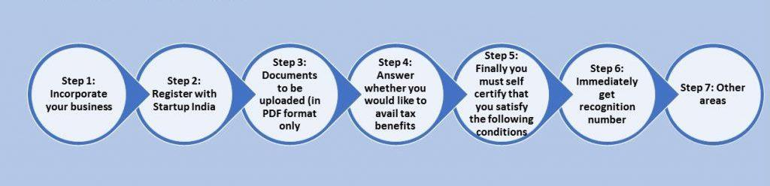
HOW TO REGISTER YOUR STARTUP WITH STARTUP INDIA

Slide 15
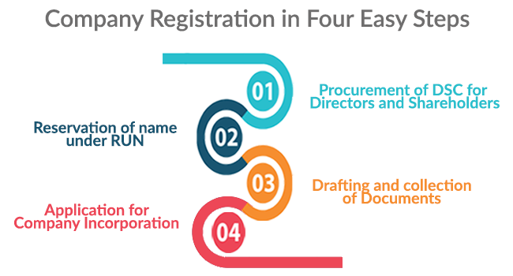

Slide 16
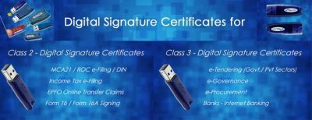

Slide 17
REQUIREMENT FOR DSC
Requirements:
2 photos
Copy of pan card {self attested}
Copy of address proof{self attested]
Address proof:
Voter id
Driving license
Passport
Aadhar card

Slide 18
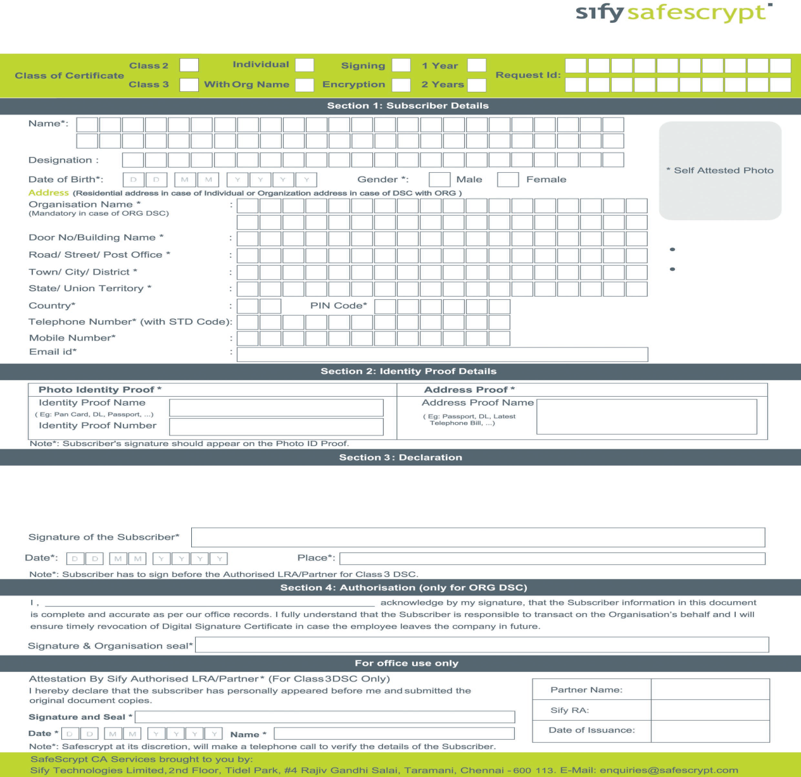
DSC FORM

Slide 19
DRAFTING AND COLLECTION OF DOCUMENTS
The Memorandum of Association and Articles of Association are considered as vital documents for a company as it prescribes the scope of operation of company and defines the how operations are carried out.
When comes to register a company as Private Limited, below three clauses are included in its AoA in addition to the general clauses.
Number of members is limited up to 200.
Transferring of shares is restricted.
Prohibition on accepting securities from public.
In addition to MoA and AoA, the application for Private Company Registration must be accompanied with following documents:
NOC from the owner of registered office address and Utility Bill;
In case the premises is rented, Rental Agreement with the registered office owner.
Consent to act as a Director of the company in form DIR – 2;
Declaration by first subscriber(s) and director(s) in form INC – 9
Certified true copy of the self-attested Identity proof of the first subscriber(s) and director(s).
Certified true copy of the self-attested Address Proof of the first subscriber(s) and director(s).

Slide 20
CHECKLIST FOR COMPANY INCORPORATION
PREPARE DIGITAL SIGNATURE:
Documents required of all proposed directors:
Identity Proof(PAN Mandatory)(self attested)
Address Proof(Self Attested)
Photo on DSC form(Cross Signed)
Signature on DSC Form
ID proof and address proof
OBTAIN DIN:
Documents required of all proposed directors:
E-MAIL ID and contact numbers (mobile numbers/telephone numbers) of all the subscribers and directors.
Photo with signature on verification page.
NAME APPROVAL:
Give at least 2 and maximum 6 names in preferential order along with the gist of proposed objectives.
INCORPORATION DOCUMENTS:
After name approval following documents will be required:
Stamp paper of value of Rs. 50 in the name of all subscribers and first directors of the company v/s ROC, Gwalior i.e. INDIVIDUALLY (INC-9) which is also required to be notarized.
Signature on Form DIR-2 individually by all the directors.
Identity proof of all Directors/subscribers of the company along with PAN(Mandatory) and any one of the following mentioned documents:
Voter Id/Passport/Driving License/ Aadhar Card
Address proof of all Directors/subscribers(any one of the following which is not older than two months):
Bank Statement/Electricity Bill/Telephone Bill/Mobile Bill
Two photographs of subscribers.
Address Proof of company(any one of the following which is not older than two months):
Bank Statement/Electricity Bill/Telephone Bill/Mobile Bill (Utility bill are mandatory)
Documents for Registered office:
If the registered office is on lease, then lease deed.
If owned by company, then ownership agreement.
If owned by director, then NOC from director along with Ownership agreement.
If on Rent, then rent agreement.

Slide 21
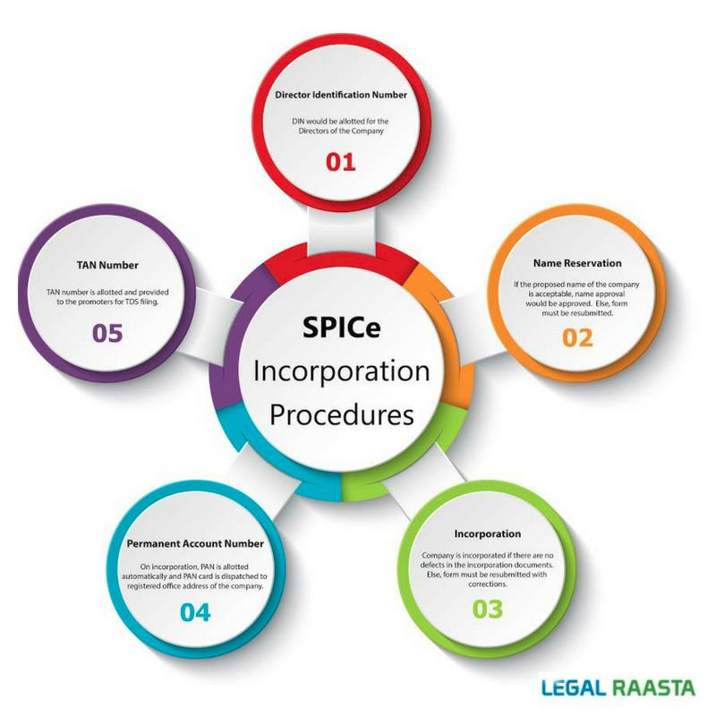

Slide 22

LLP Vs Private Limited Company

Slide 23
LLP is an alternative business form that gives the benefits of limited liability of a Company and the flexibility of a general partnership.
Limited liability partnerships (LLPs) are growing in number since their introduction in 2008, but they should be more popular than they now are. This is because the LLP offers nearly all the benefits of a private limited company, with none of the downsides of a partnership firm. It offers limited liability, offers tax advantages, can accommodate an unlimited number of partners, and is credible in that it is registered with the Ministry of Corporate Affairs (MCA). At the same time, it has fewer compliances than a private limited company and is also significantly cheaper to start and maintain.

Slide 24
OBJECTIVITY OF FOUNDER
Startups should decide based on their long term objectivity, in the initial stage, the size of operation would be small, but they should ask themselves where they want to see their startup down the line say five years.
The structure and governing law of Company makes it easier for infusion of stake-holders, investors, professionals in the Company.
LLP is more suitable is the startups is intending to run a small scale concern covering a particular area.
INCORPORATING COST AND PROCEDURES
Incorporating a LLP is cost effective compared to a Company.
TAXATION AND AUDIT COMPLIANCES
The LLP Act provides that the partners of such LLP if decided not to get audit of the accounts of the LLP then such LLP shall include in the Statement of Account and Solvency a statement by the partners to the effect that the partners acknowledge their responsibilities for complying with the requirements of the Act and the Rules with respect to preparation of books of account and a certificate in the Form 8.
OWNERSHIPS AND DEBT EXPOSURE
In LLP, the designated partners have the right to manage the business directly unlike Companies, where there is no direct relationship between ownership and management. In a Company, the stakeholder appoints board of directors to run and manage day to day affairs of Company.
Thus, forming LLP is suitable for startups, where the business is to be managed by few partners who are each making a similar contribution and are drawing similar salaries and the objective of the founder is to have direct control over the affairs of the business.

Slide 25
CONCLUSION
Technology, in both its evolutionary form and in its revolutionary form, as changed our lives drastically. In recent times, some of the products and services that have transformed the way we live, such as Tablets, smart phones, the Internet, social media etc., have been a result of revolutionary innovation. Great innovation led by visionary leaders have made this possible. The changes have been adopted rapidly, and most of us cannot really remember what it was like before we had these products and services even though they have seeped into our lives only recently. There are some products, or we can say by-products, of these revolutionary organizations that impact lives in a more non-obvious evolutionary way.
Apart from delivering value to their customers, startups have a direct impact on the cities they make their homes. Infosys has impacted Bangalore and Alibaba has changed Hangzhou. What Google has done to Mountain View and how Microsoft transformed Redmond are case studies in themselves.
When these startups grew, they directly impacted growth of their cities as well. Employment opportunities for youth increased and new employment patterns came into picture. Demand and employment opportunities for engineers saw a steep rise.

Slide 26


